Slide 1
Classifying Chest Cancer CT Scan Images
Comparisons of approach
Devin Lim, Zahra Ahmadi, Sai Kishore Chintala

Slide 2
Goal
Adenocarcinoma
Squamous Cell Carcinoma
Chest Cancer CT Scan Images
Classifier
Large Cell Carcinoma
Healthy / No Cancer
Notes:
Kishore

Slide 3
Data Source
Size of data:
Training set is 70%, testing set is 20%, validation set is 10%
Total of 997 images.
Source of data:
Uploaded to Kaggle by Mohamed Hanny, a Data Scientist from Cairo
Collected from various (unexplained) sources
Quality of data:
Few duplicates
Various resolutions
Informed consent and privacy:
No PII in data, N/A
Notes:
Kishore

Slide 4
Problem
Type of problem:
Supervised learning
Classification
Method used to solve problem:
Neural networks
Notes:
Kishore

Slide 5
Background: Neural Networks
Neural Network Structure
A neural network is composed of layers, typically organized into two main parts: the “body” and the “head”:
The body consists of the earlier layers, and is responsible for learning general features and patterns from the data (input and the hidden layers)
The “head” consists of the later layers responsible for making specific predictions or classifications based on the features learned by the “body”(output)
In classification tasks the head would include one or more fully connected layers that culminate in an output layer designed to produce the final classification results

Slide 6
Background: Transfer learning and fine tuning
Transfer learning is a technique where a pre-trained neural network is adapted for a new task or data set
Fine tuning is a specific form of transfer learning where the pre-trained model is further trained on the new task
Final layers is unlikely to be of any use for us when we are fine-tuning in a transfer learning setting, because it is specifically designed to classify the categories in the original pre-training dataset.
So when we do transfer learning, we replace it with a new linear layer for our desired task.
This newly added linear layer will have entirely random weights. Therefore, our model prior to fine-tuning has entirely random outputs.
Notes:
Zahra : but it is not an entirely random model
l! All of the layers prior to the last one have been carefully trained to be good at image classification tasks in general

Slide 7
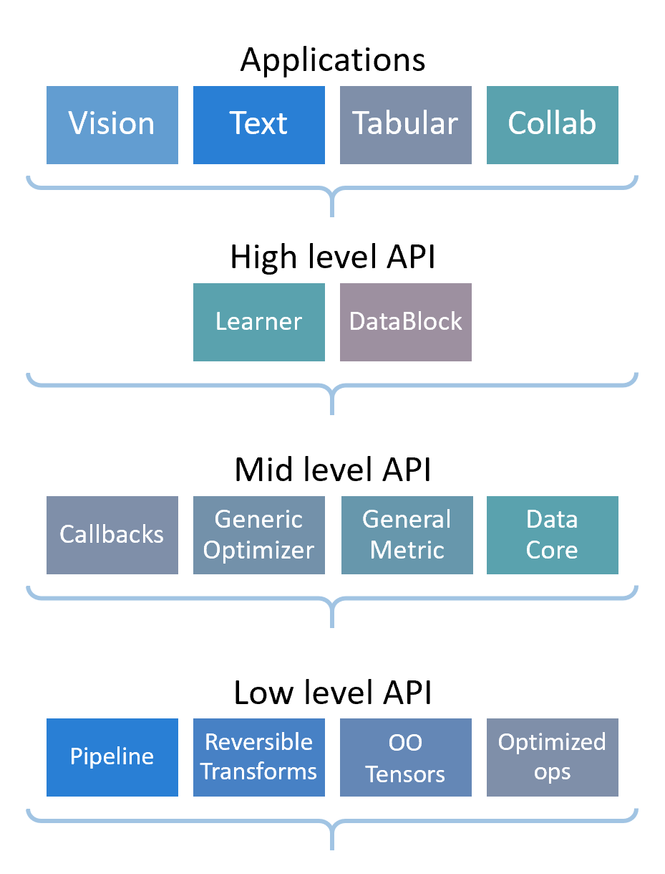
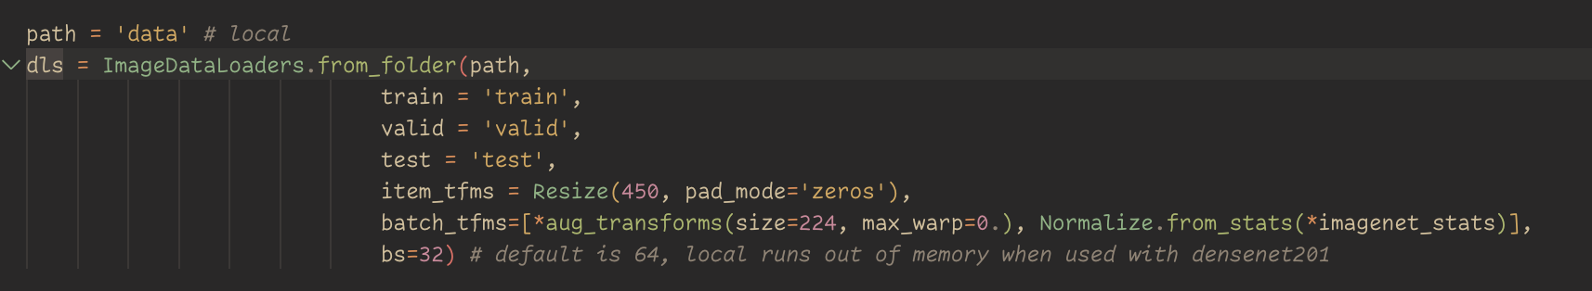
Step 1: Data Processing – fastai DataBlock and DataLoader
DataBlock is responsible for:
Loading the data
Split into training, testing, and validation sets
Labelling items
Preprocessing items
Split items into batches
DataLoaders sets up DataBlocks under the hood
Notes:
Devin
Data Loaders Creation: ImageDataLoaders.from_folder is used to create image data loaders from the specified folder. This method is convenient for image classification tasks where images are organized in folders.
train='train': Specifies the subfolder within path that contains training data.
valid='valid': Specifies the subfolder for validation data.
test='test': Specifies the subfolder for test data.
Item Transforms:
item_tfms = Resize(450, pad_mode='zeros'): Each image in the dataset is resized to 450x450 pixels. If the original image is not square, padding is added using zero padding (black borders).
Batch Transforms:
aug_transforms(size=224, max_warp=0.): Applies data augmentation techniques (like rotation, zooming) to the images, resizing them to 224x224 pixels. max_warp=0 disables the warping augmentation.
Normalize.from_stats(*imagenet_stats): Normalizes the images using the statistics (mean and standard deviation) from the ImageNet dataset, which is a common practice in image processing to improve model training.
Batch Size (bs):
bs=32: Sets the batch size to 32. Batch size is the number of samples processed before the model is updated. The default is usually 64, but it's reduced here to prevent memory issues, particularly when using memory-intensive models like DenseNet-201.

Slide 8
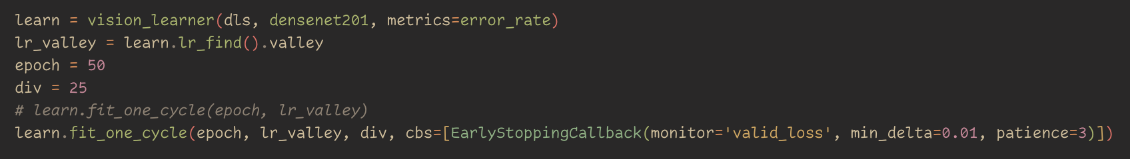
Step 2: Modelling - fastai Learner
fastai Learner is made up of Pytorch model + optimizers + loss function + DataLoader
“The Learning Rate is the most important hyper-parameter to tune”
“The recommended way of training models is using a variant of the 1cycle policy”
Howard, Jeremy, and Sylvain Gugger. “Fastai: A Layered API for Deep Learning.”
Notes:
Devin, Zahra to talk about fit_one_cycle parameters

Slide 9
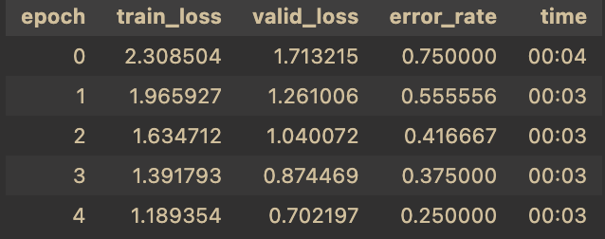
Background: Epoch and 1cycle policy
Epoch
Refers to one complete training cycle through the entire training dataset. During an epoch, the model's parameters (weights and biases) are updated based on the error calculated on each batch
1cycle policy
Adjusts learning rate and momentum (a concept related to gradient descent) cyclically
Start training at a low learning rate, gradually increase it for the first section of training, and then gradually decrease it again for the last section of training
Initial learning rate provided by learning rate finder
Notes:
Zahra

Slide 10
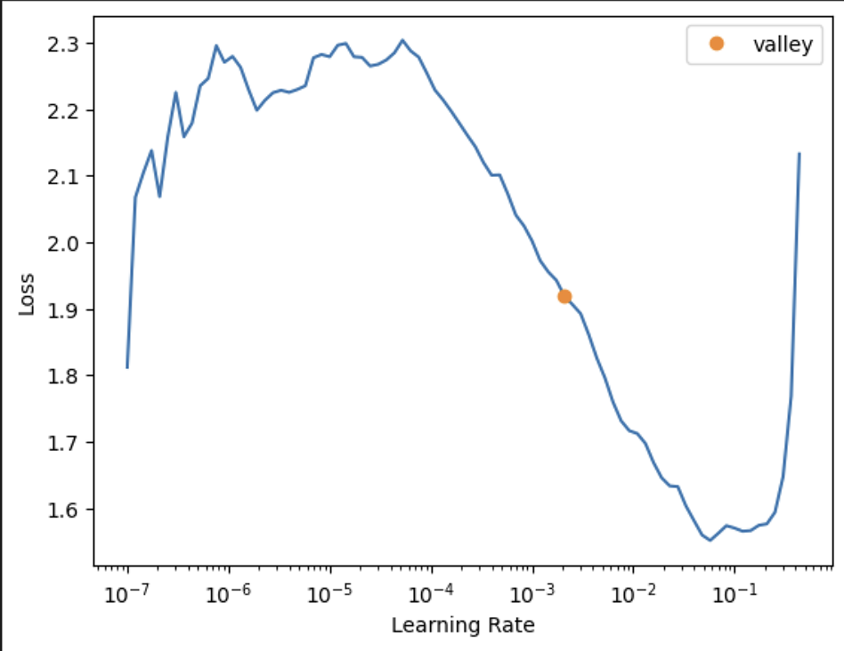
Learning Rate
If our learning rate is too low, it can take many epochs to train our model.
Wastes time
Risk of overfitting
Learning Rate Finder
Automated approach based on LR Range test by Leslie Smith
Start with a very, very small learning rate, something so small that we would never expect it to be too big to handle. We use that for one mini-batch, find what the losses are afterward, and then increase the learning rate by a certain percentage (e.g., doubling it each time). Then we do another mini-batch, track the loss, and double the learning rate again. We keep doing this until the loss gets worse.
Notes:
epoch: This represents one complete pass through the entire training dataset. Machine learning models are typically trained over multiple epochs. Seeing epochs from 0 to 4 indicates that the model has completed 5 training cycles.
train_loss: This is the loss function computed on the training dataset. The loss function quantifies the difference between the predicted outputs of the model and the actual outputs (targets). The goal of training is to minimize this value.
valid_loss: This is the loss function computed on a separate validation dataset that is not used for training. This metric is crucial for understanding how well the model generalizes to unseen data.
error_rate: This represents the proportion of incorrect predictions out of the total predictions made on the validation dataset. A lower error rate indicates better performance.
time: This shows how long each epoch took to run. It's useful for tracking the efficiency of the training process.
Looking at the trends in the table:
Decreasing train_loss and valid_loss: Both loss metrics are decreasing over time, which suggests that the model is learning and improving its predictions with each epoch.
Decreasing error_rate: The error rate is also decreasing, which indicates the model is making fewer mistakes on the validation set as training progresses.
Stable time: The time taken for each epoch is fairly consistent, which is expected unless there are changes in the computing environment or the dataset.
Implications of these trends are positive for the training process, as they indicate the model is learning effectively. However, it's important to also watch for the gap between train_loss and valid_loss. If the train_loss continues to decrease while the valid_loss starts to increase, it could be a sign of overfitting, where the model learns the training data too well, including its noise and outliers, and performs poorly on unseen data.

Slide 11
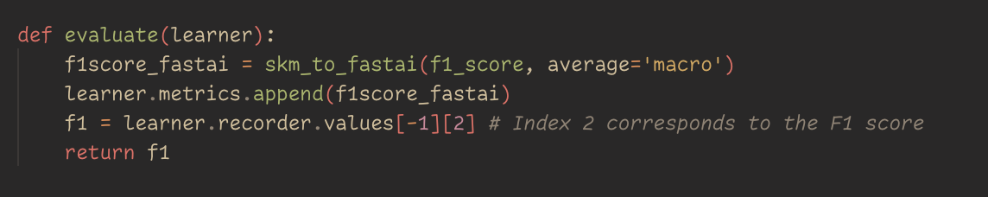
Step 3: Evaluation - sklearn.metrics and skm_to_fastai
fastai allows the use of scikit-learn metrics
We compare the performance of our models using classification matrix and f1 scores
Notes:
Devin

Slide 12
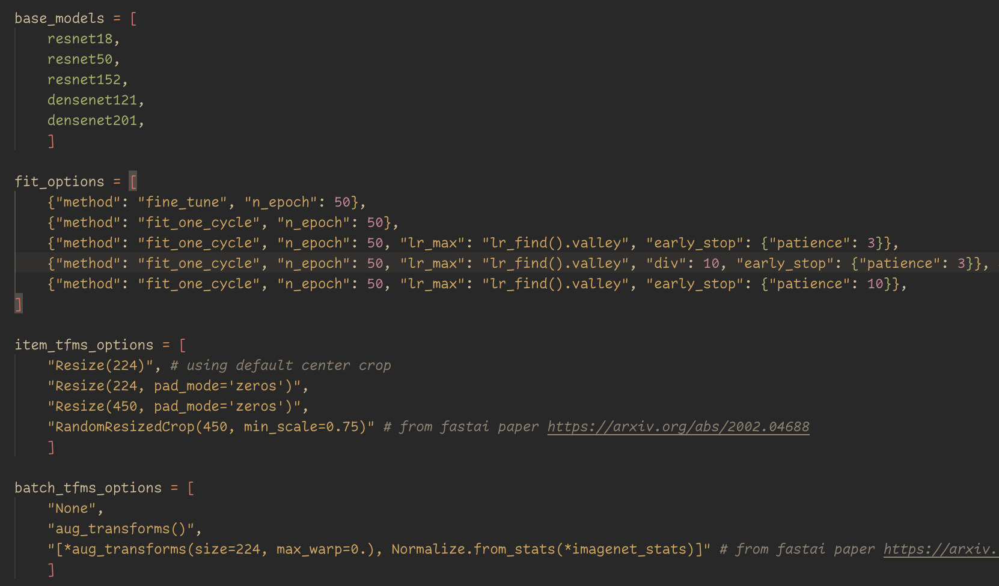
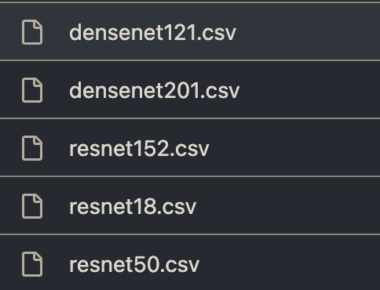
Experiments
Automated testing of various parameters

Slide 13
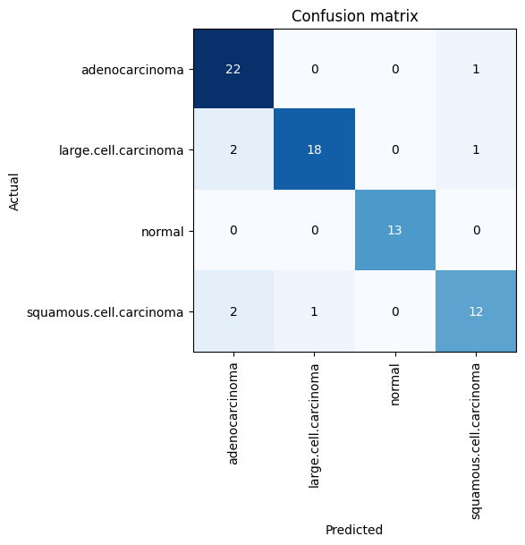
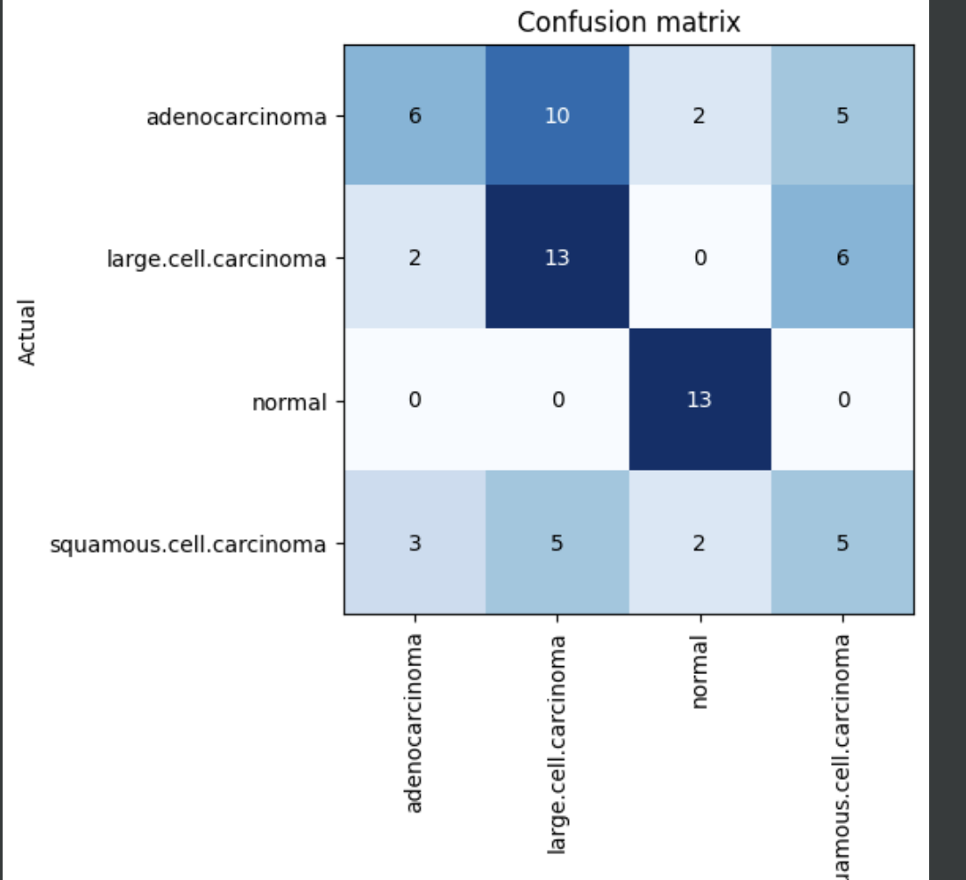
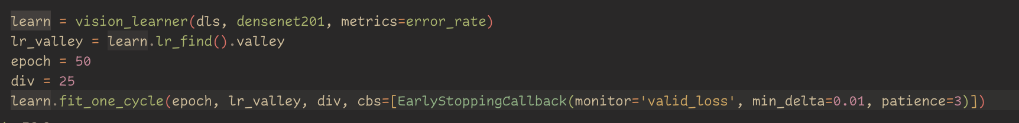
Result
Best performance:
F1 Score of 0.92
7/72 misclassifications
Notes:
Devin

Slide 14
Challenges
Hardware limitation: GPU memory
Factors: Batch size, image sizes (through transformations / resizing)
Training time / GPU performance
Factors: Model size (e.g. resnet34 vs resnet152), number of permutations
Notes:
Devin

Slide 15
Next Steps
Perform correlation analysis on result
Include batch size as a parameter in performance analysis tables
Rerun the full test on more powerful hardware → cloud resources
Notes:
Devin

Slide 16
Citations
Howard, Jeremy, and Sylvain Gugger. “Fastai: A Layered API for Deep Learning.” Information, vol. 11, no. 2, Feb. 2020, p. 108. arXiv.org, https://doi.org/10.3390/info11020108.
He, Kaiming, et al. Deep Residual Learning for Image Recognition. arXiv:1512.03385, arXiv, 10 Dec. 2015. arXiv.org, https://doi.org/10.48550/arXiv.1512.03385.

Slide 17
Links
https://github.com/davay/data5100
https://www.kaggle.com/datasets/mohamedhanyyy/chest-ctscan-images/

